Slide 1

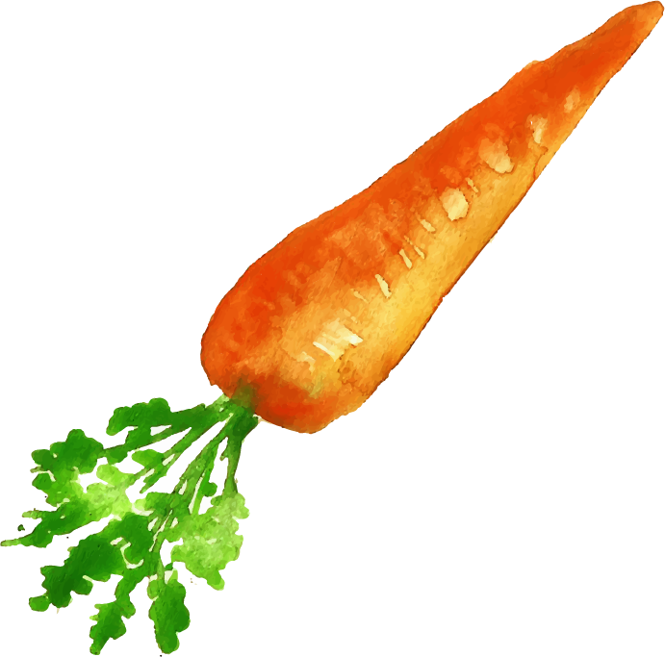





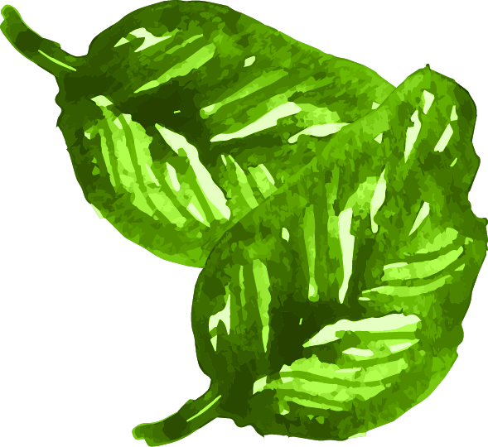
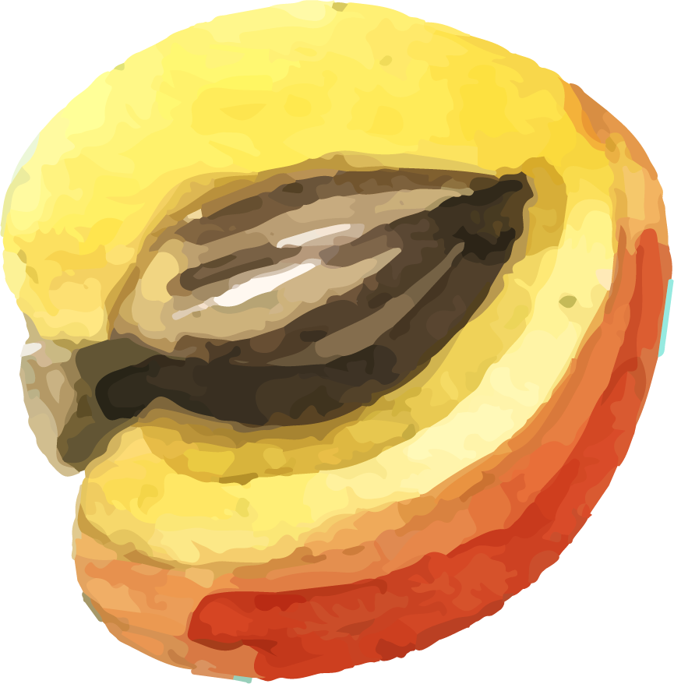
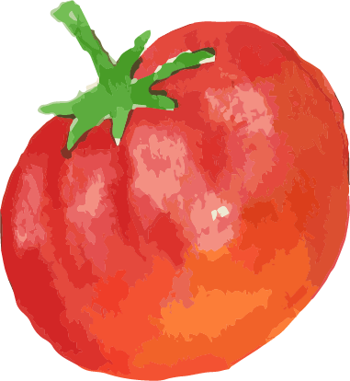
What to Eat Today?
Healthy Diet Recommendation System
Supervisor:
Dr. Thomas Canhao XU
Dr. John Changjiang ZHANG
Students:
Frank Xinyan XIE, Connor He XU

Slide 2
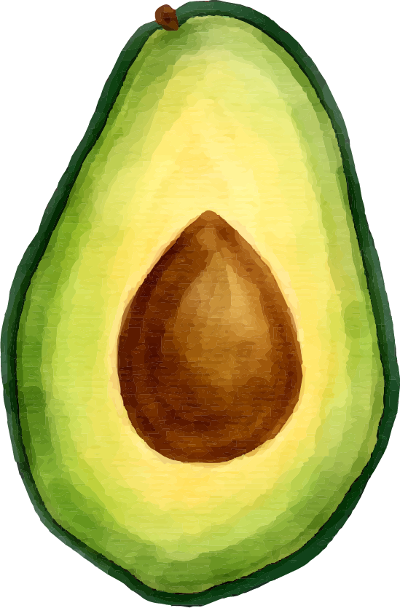
TABLE OF CONTENTS
01
02
03
Topic Introduction
Dataset introduction
Nutritional Background Information
04
05
06
Search by nutritional standards using Elasticsearch
Find Similar Users by Collaborative Filtering
Architecture of Web Interface

Slide 3
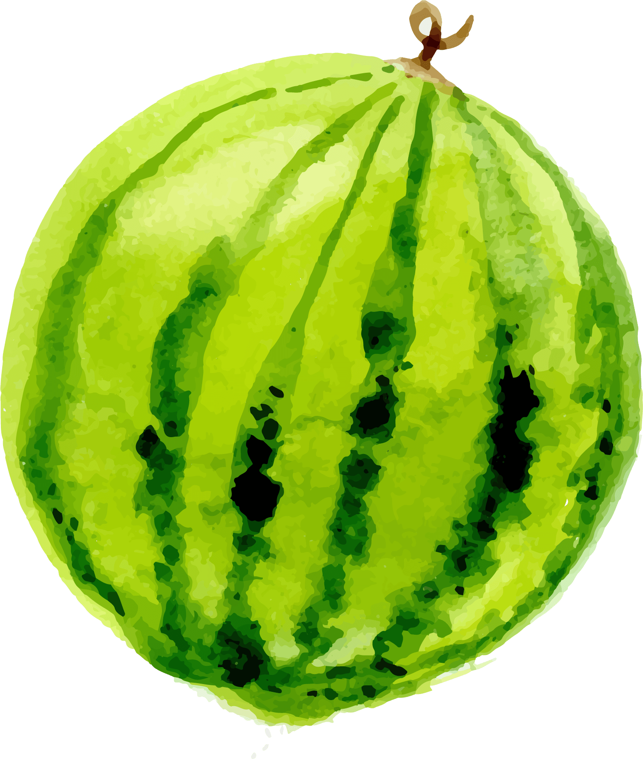

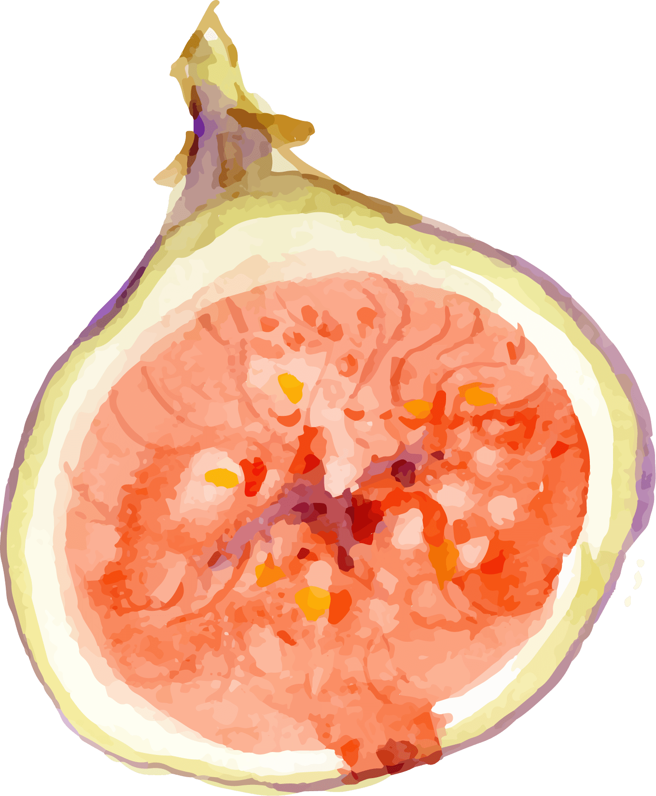



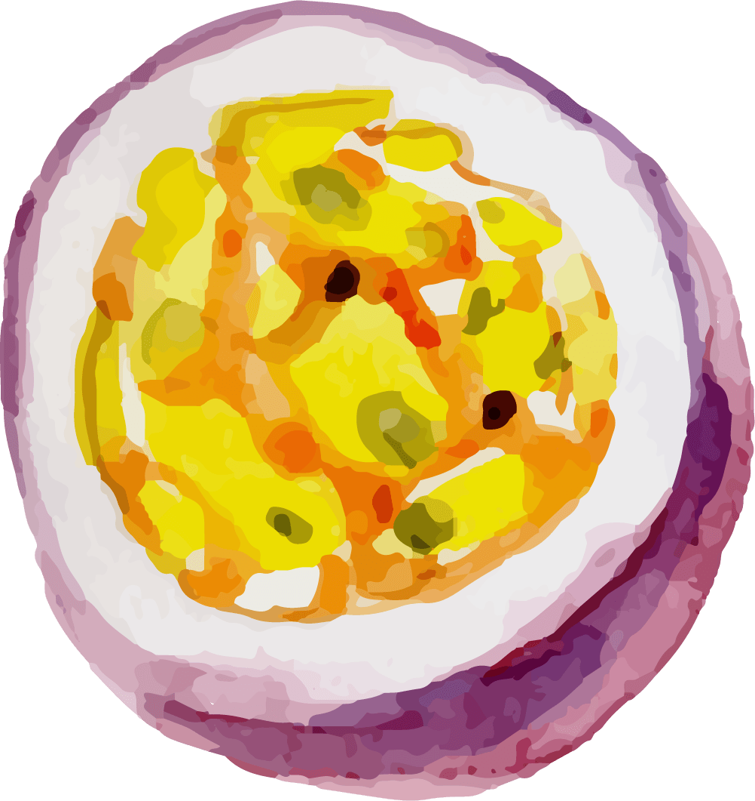
01
Topic introduction

Slide 4



Introduction
Eat healthier
Eat what you like
Goal
Methods
Our main objection is to develop a website for everyone to find their diet plan according to their personal physical condition.
Elasticsearch & Collaborative Filtering
Python + Django architecture for website frontend

Slide 5

Website function
BMR & TDEE
History Recording
Food Nutrient databases
Recommendation
Calculated number for different ranges of people
Implemented coefficient for sports level
Uploaded user’s history dietary
User actively record their food
Listed out thousands of food nutrient information
Combined Elasticsearch & Collaborative Filtering to give user more appropriate food selections

Slide 6
02
Dataset introduction

Slide 7



OUR Dataset
We selected our datasets which came from a website in HKSAR called “Centre for Food Safety” https://www.cfs.gov.hk/.
Aquatic animals other than fish
Meat and meat products
Eggs and egg products
Cereals and cereal products
Milk and milk products
Poultry and poultry products
Vegetables and vegetable products
Fruits and fruit products
Fish and fish products

Slide 8

Data Labels
Energy (kcal)
Protein (g)
Carbohydrates (g)
Fat (g)
Dietary Fiber (g)
sugar (g)
Saturated Fat (g)
Trans fat (g)
Cholesterol (mg)
Sodium (mg)
Calcium (mg)
Vitamin C (mg)
Main Ingredient
Lipid
Minerals and Vitamins

Slide 9
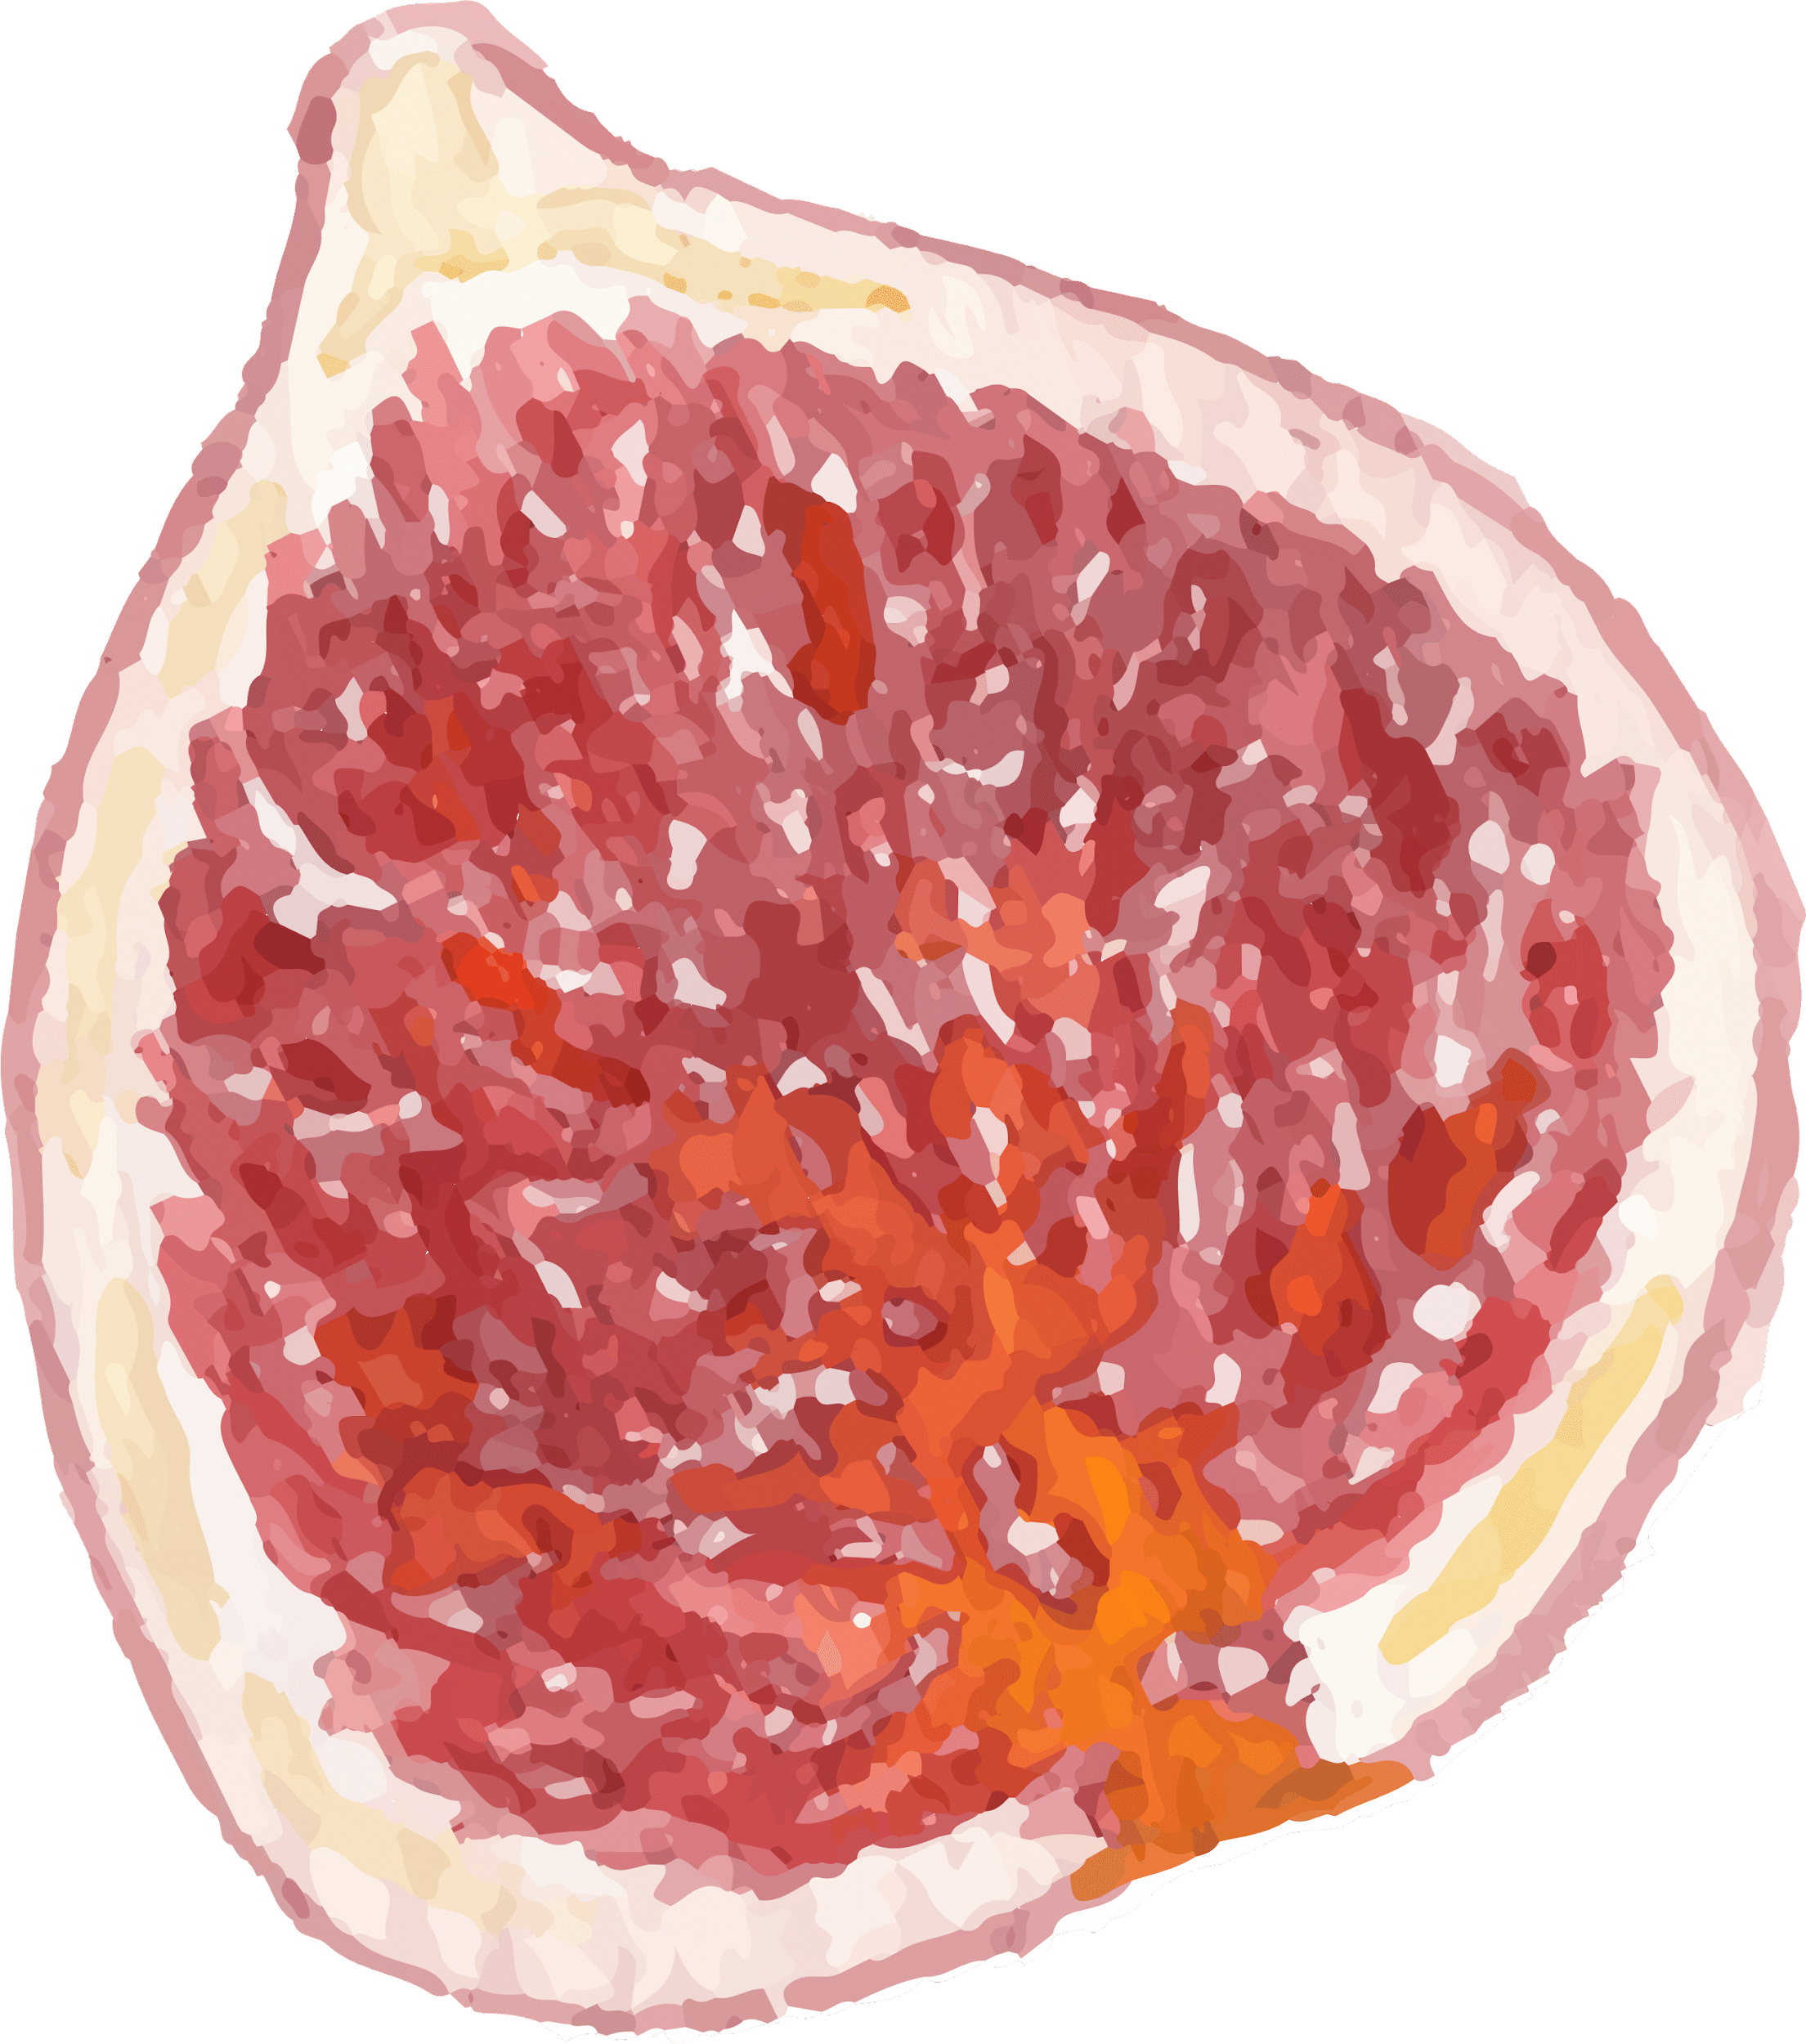
Examples in our dataset
In the meat, it can be seen that the general calorie is relatively high, and the kcal distributed in the range of 0-500 is very large.
We can find that the calorie distribution of vegetables is relatively scattered. After looking at the data set, we found that the practice of vegetables largely determines this. Raw vegetables are usually low in calories. But after cooking, they increase a lot.

Slide 10
03
Nutritional Background Information

Slide 11
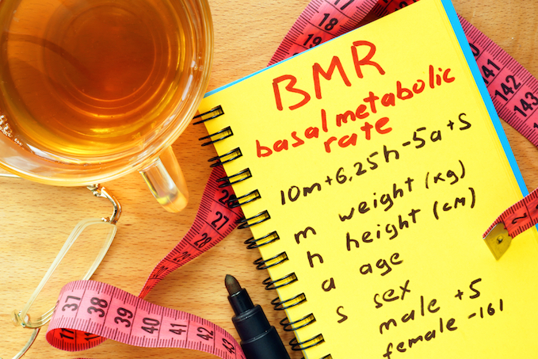


BMR (Basal Metabolic Rate)
Notion:
Basal metabolic rate (BMR) is the rate of energy expenditure per unit time by endothermic animals at rest, the unit as kJ/(m^2·h)
In humans, BMR is directly proportional to a person's lean body mass. In other words, the more lean body mass a person has, the higher their BMR; but BMR is also affected by acute illnesses and increases with conditions like burns, fractures, infections, fevers, etc.

Slide 12
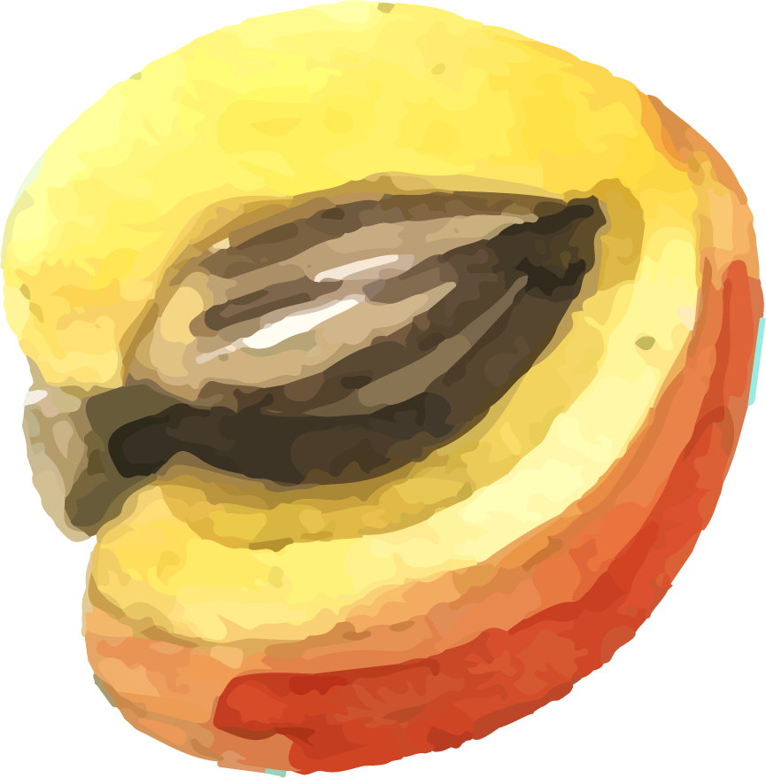


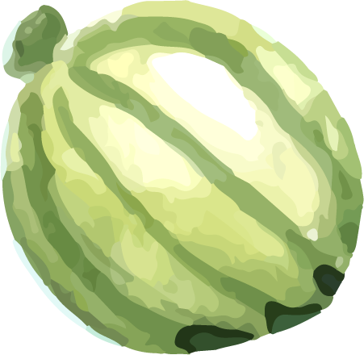

Mifflin St Jeor Equation
a instead of age (years)
m instead of mass (kg)
s is +5 for males and −161 for females,
h instead of height (cm)
BMR $=\left(\frac{10.0m}{1kg}+\frac{6.25h}{1cm}−\frac{4.92a}{1 \text{year} }+s\right)\frac{kcal}{day}$
Connor:
Height: 186cm, Weight: 100kg, Age: 21, Male
Final BMR result: 2063 kJ/(m^2·h)
Frank:
Height: 175cm, Weight: 65kg, Age: 22, Male
Final BMR result: 1640 kJ/(m^2·h)

Slide 13
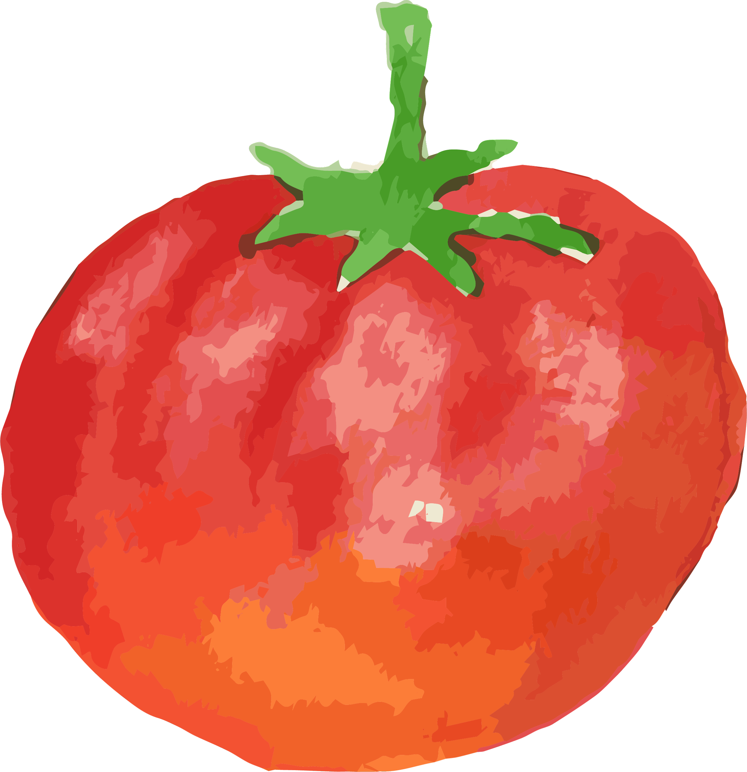
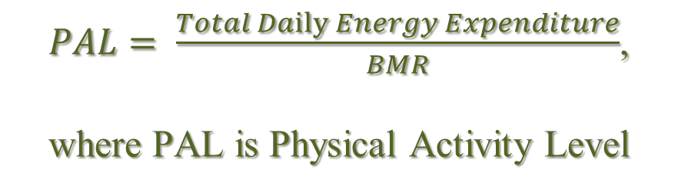
TDEE (Total Daily Energy Expenditure)
BMR Basic and Standard (More important in theories)
TDEE Actual and Practical (More important in daily life)
Relation
$PAL= \frac{Total Daily Energy Expenditure}{BMR}$,
where PAL is Physical Activity Level

Slide 14
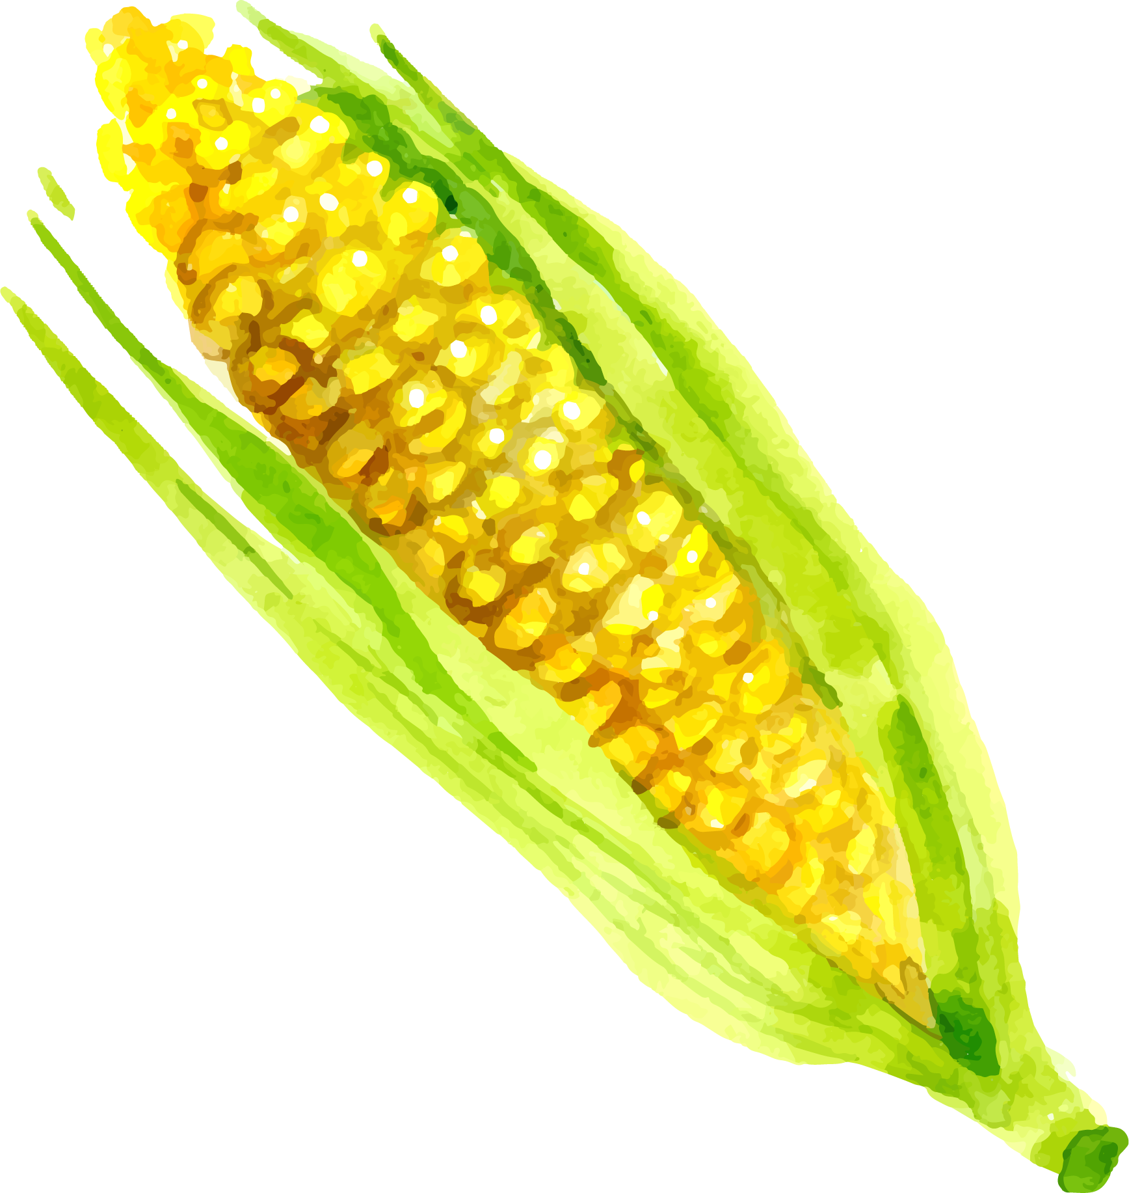

PAL (Physical Activity Level)
 | Execrise Frequency | Number
Sedentary | Little or no exercise | 1.2
Lightly active | Light exercise/sports 3-5 days a week | 1.375
Moderately active | Moderate exercise/sports 3-5 days a week | 1.55
Very active | Hard exercise/sports 6-7 days a week | 1.72
Extra active | Hard exercise/sports 6-7 days a week, plus physical job | 1.9

Slide 15
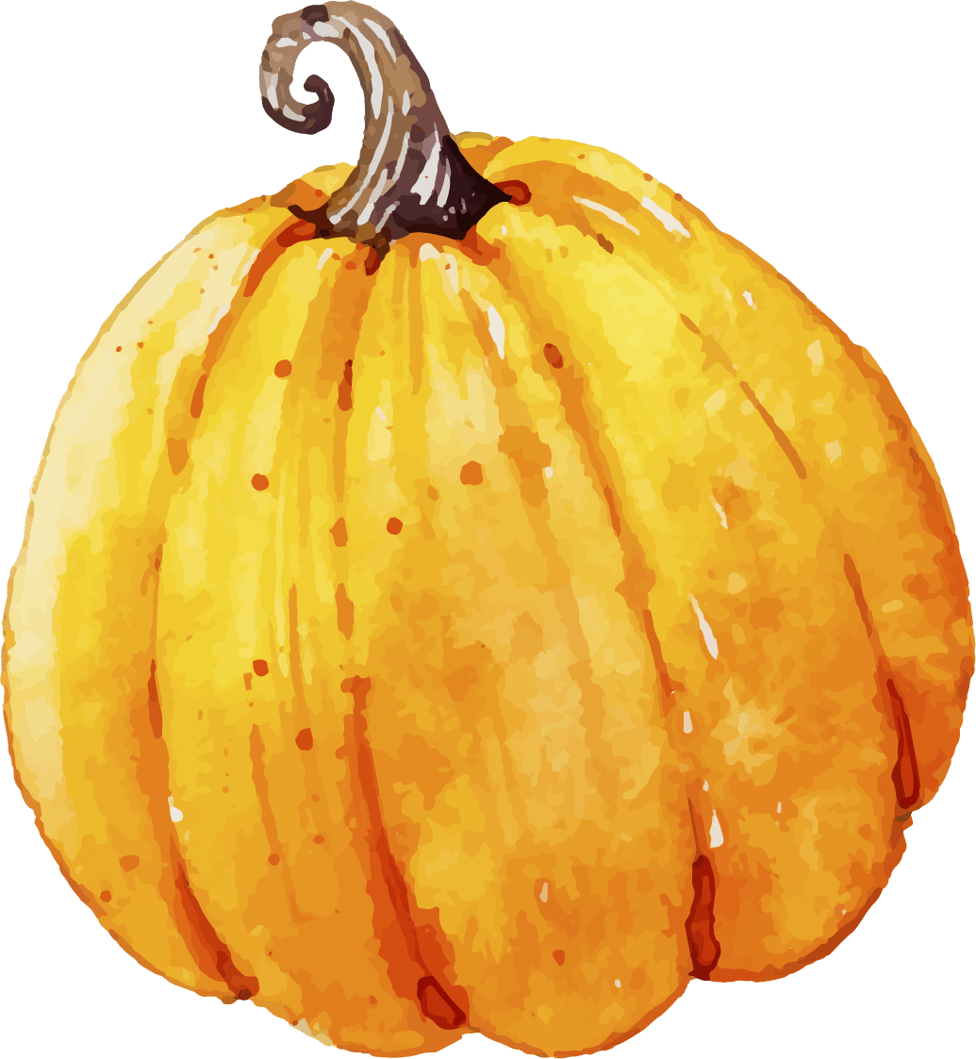

According to “The Chinese dietary guideline (2022)”
Salt | Less than 5g
Oil | 25~30g
Milk & Milk product | 300~500g
Meat | 120~200g
Vegetable | 300~500g
Fruit | 200~350g
Cereal | 200~300g
Water | 1.5~1.7L
Calories produced by Carbohydrates = 4 kcal (4 kcal)/gram
Calories produced by protein = 4 kcal (4 kcal)/g
Calories produced by fat = 9 kcal (9 kcal)/g

Slide 16
For other trace elements (dietary fiber, sodium, vitamin C, calcium), because their amounts should be consumed each day is basically the same for people with different conditions (gender, age, etc.), we find the table in “The Chinese dietary guideline (2022)” as below:
For other trace elements (dietary fiber, sodium, vitamin C, calcium)
Dietary fiber | 25g
Calcium | 800mg
Sodium | 1500mg
Vitamin C | 100mg

Slide 17
Proportion Information
For Fat, Carbohydrates, Protein, Sodium, and Calcium:
the proportion is the distribution of their quantities, and the calory numbers are mainly obtained from these elements;
For Dietary Fiber:
Dietary fiber only exists in fruits, vegetables and cereals, so the proportion is the distribution of only these 3 categories;
For Vitamin C:
Because VC cannot exist in high temperature, it can only be obtained from fruits (mainly raw), so the proportion of VC is only supplied by fruits.

Slide 18
04
Search by nutritional standards using Elasticsearch

Slide 19
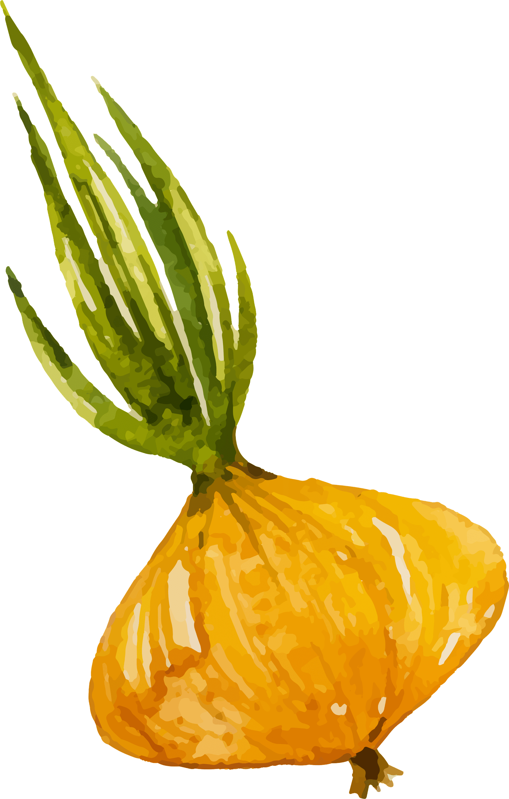

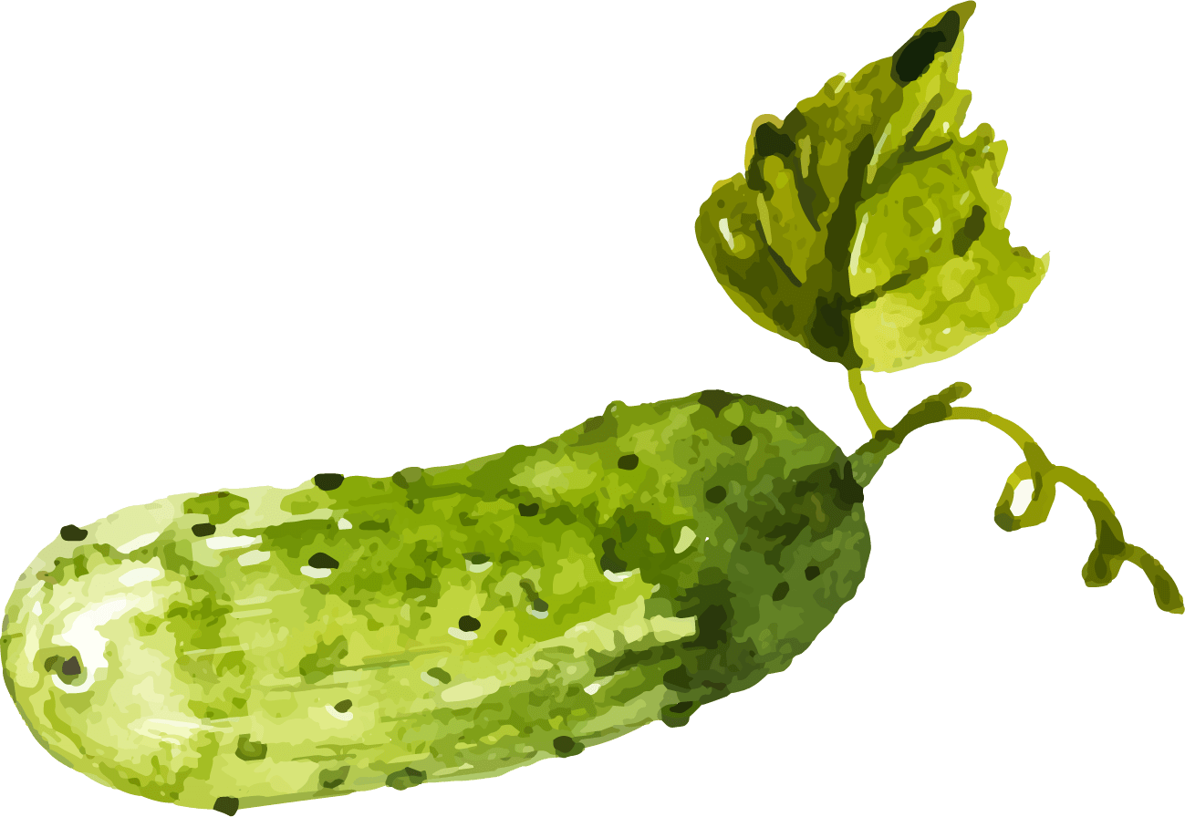
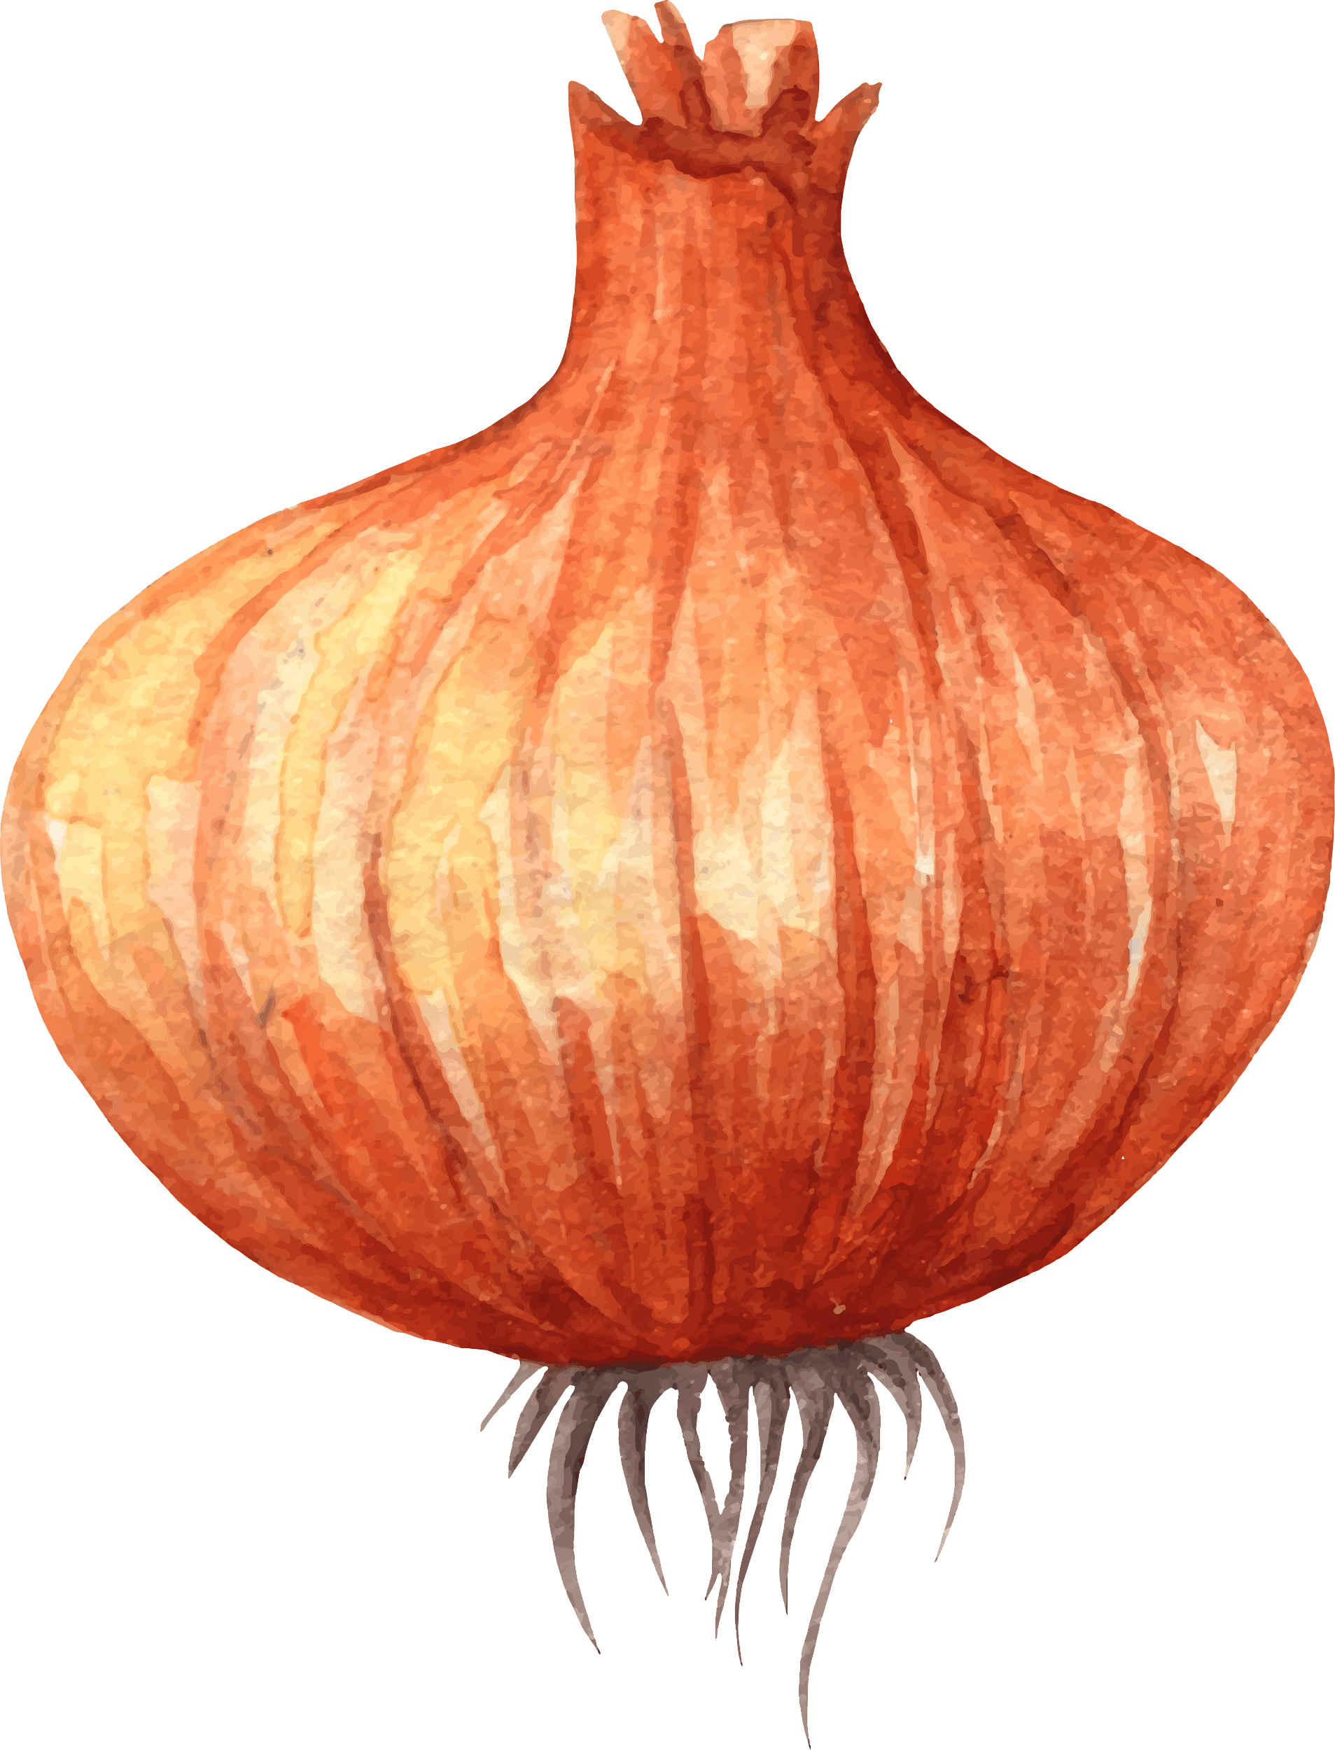
Motivations and Goals
To find recipes for the users based on their body information in the food database that best meet their nutritional needs.
Since our website records users' height, weight, age, gender, activity level and dietary goals during registration, we can set nutritional standards by BMR, TDEE, fixed values of micronutrients, etc. and then use Elasticsearch for a custom scoring script to search for ingredients that are closest to the standards.

Slide 20
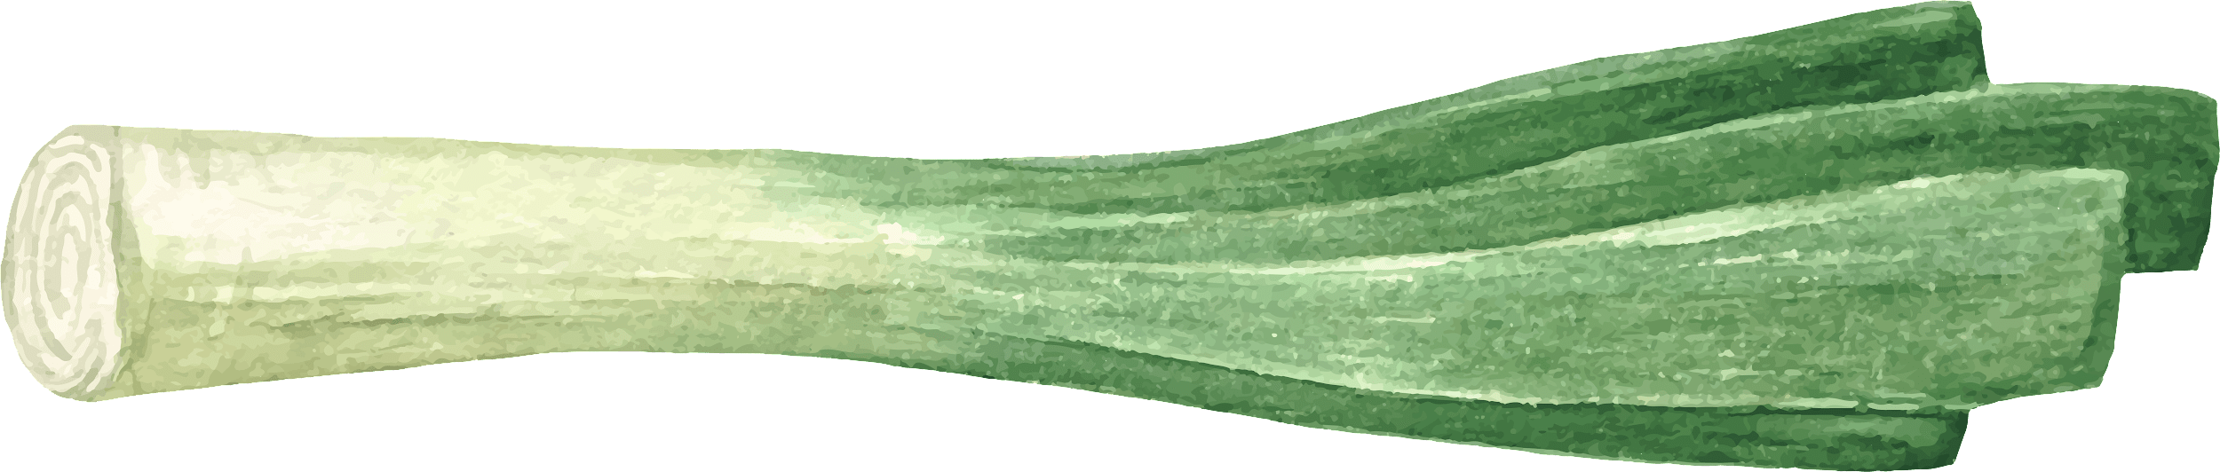
Advantages
Faster Speed Relative to MySQL
Distributed Storage of Data (indexes & shards)
Support for Complex Query Methods and Custom Scripts

Slide 21
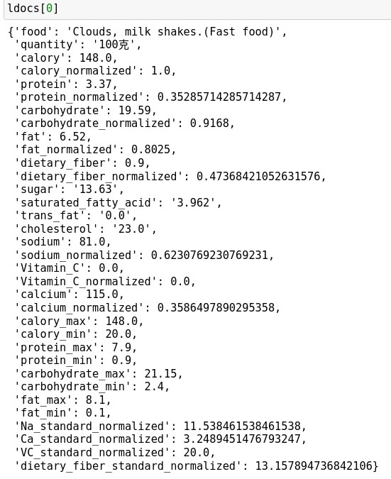
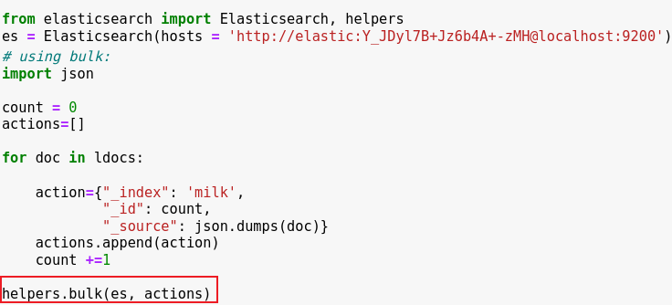
Indexing
“bulk” method: accelerate the speed and efficiency of indexing for large amount of data:
JSON Structure

Slide 22
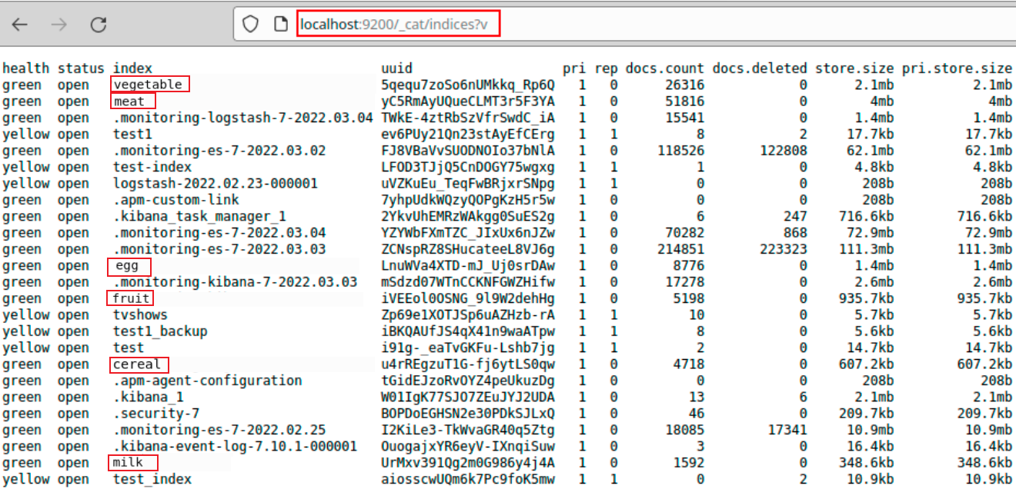
Indexing
6 Indexes

Slide 23
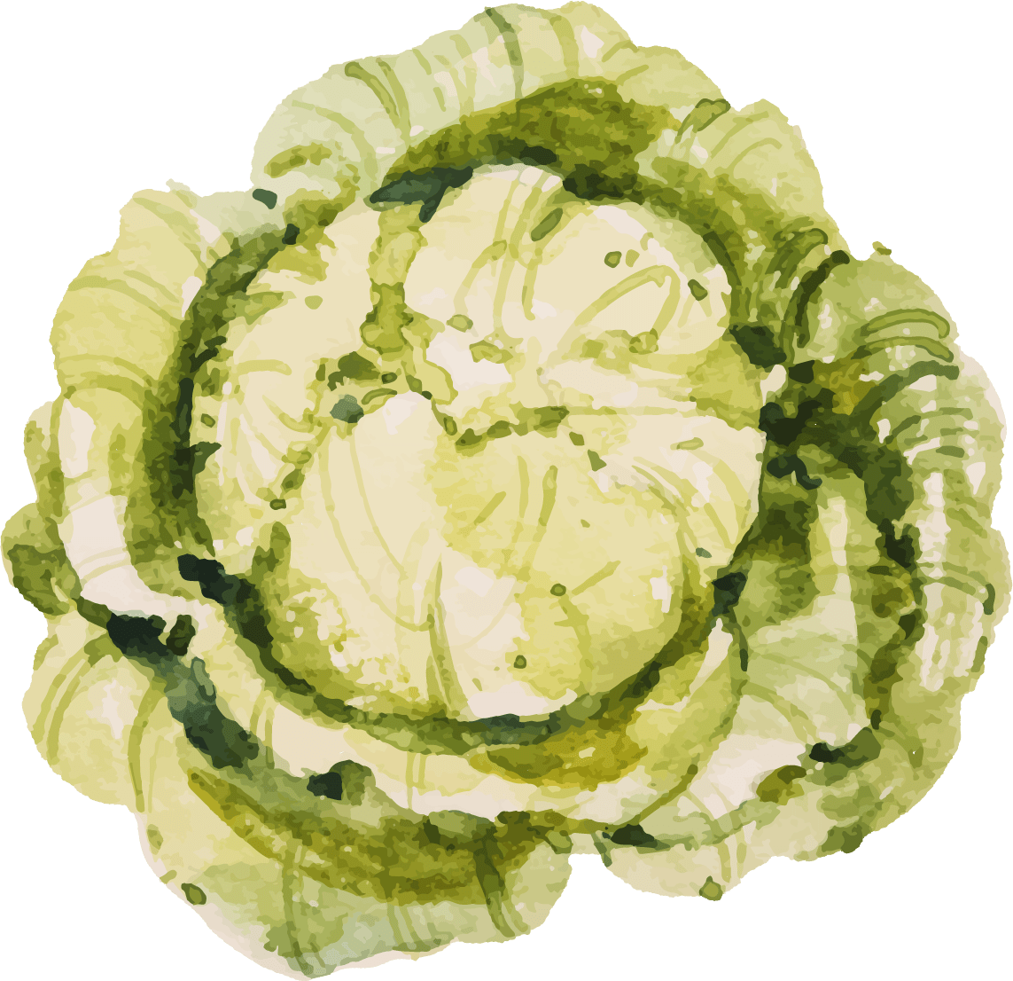

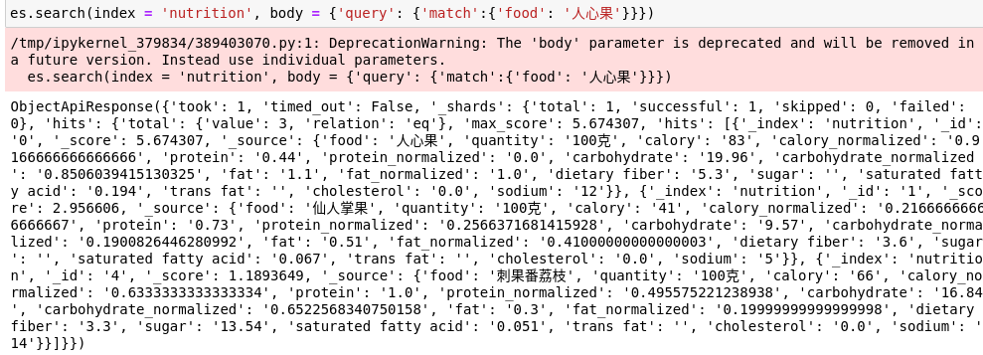
Scripted Scoring
By default, Elasticsearch uses the BM25 algorithm as a search method to perform a TFIDF-like text search based on word frequency, so we can conduct search like following:
In addition to that, ES allows us to customize the search algorithm, like following:

Slide 24


Scripted Scoring
Firstly, based on user information (weight, height, age and gender), calculate the BMR (Basal Metabolic Rate) of each user:
script_query = {"script_score": {"query": {"match_all": {}},"script": {"source": '''double BMR = 9.99 * params.weight + 6.25 * params.height - 4.92 * params.age + 166 * params.gender - 161 + params.bias;

Slide 25
Scripted Scoring
Active level
tends to be static: 1.2
low activity level: 1.375
normal activity level: 1.55
high activity level: 1.72
intense activity level: 1.9
TDEE (Total Daily Energy Expenditure)
Standard of Calory (Normalized)
double TDEE = BMR * params.active_level;
double TDEE_normalized = (TDEE - doc['calory_min'].value) / (doc['calory_max'].value - doc['calory_min'].value) * ratio1;

Slide 26
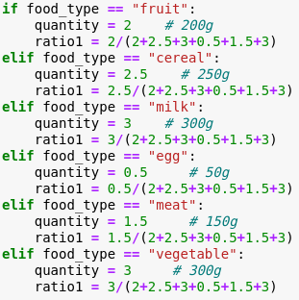
Scripted Scoring
Ratio1: proportionally divide the total daily nutrient content into individual food groups (based on the proportion, according to the respective quantity share):

Slide 27
Scripted Scoring
TDEE can be divided into 3 sources: protein, fat and carbohydrate. The proportion is 0.15, 0.25 and 0.65 respectively (Daily calory intake: 15% from protein, 25% from fat, and 65% from carbohydrate).
Based on that, we can calculate the standard for the 3 types separately (as well as normalization for that values):
double protein standard = TDEE * 0.15;
double protein_standard_normalized = (protein_standard - doc['protein_min'].value) / (doc['protein_max'].value - doc['protein_min'].value) * ratio1;
double fat_standard = TDEE * 0.25;
double fat_standard_normalized = (fat_standard - doc['fat_min'].value) / (doc['fat_max'].value - doc['fat_min'].value) * ratio1;
double carbohydrate_standard = TDEE * 0.65;
double carbohydrate_standard_normalized = (carbohydrate_standard - doc['carbohydrate_min'].value) / (doc['carbohydrate_max'].value - doc['carbohydrate_min'].value) * ratio1;

Slide 28
Scripted Scoring
Using the standards, we can calculate the difference (absolute value) between them (normalized) and the amount of each type of nutrients from each food (only for calory, protein, carbohydrate, fat, Na, and Ca):
double calory_res = TDEE_normalized - params.quantity * doc['calory_normalized'].value;
double protein_res = protein_standard_normalized - params.quantity * doc['protein_normalized'].value;
double fat_res = fat_standard_normalized - params.quantity * doc['fat_normalized'].value;
double carbohydrate_res = carbohydrate_standard_normalized - params.quantity * doc['carbohydrate_normalized'].value;
double Na_res = doc['Na_standard_normalized'].value * ratio1 - params.quantity * doc['sodium_normalized'].value;
double Ca_res = doc['Ca_standard_normalized'].value * ratio1 - params.quantity * doc['calcium_normalized'].value;

Slide 29
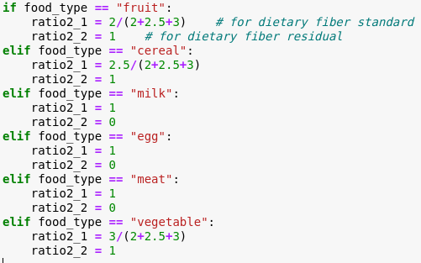
Scripted Scoring
Dietary fiber only exists in fruits, vegetables and cereals, two parameters: ratio2_1 and ratio2_2 for it to calculate the standard and residual value exclusively:
double dietary_fiber_standard_normalized = doc['dietary_fiber_standard_normalized'].value * ratio2_1;
double dietary_fiber_res = (dietary_fiber_standard_normalized - params.quantity * doc['dietary_fiber_normalized'].value) * ratio2_2;

Slide 30
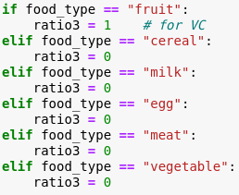
Scripted Scoring
Vitamin Conly exists in fruits (because it would be broken in high temperatures), we use ratio3 to calculate its residual:
double VC_res = (doc['VC_standard_normalized'].value - params.quantity * doc['Vitamin_C_normalized'].value) * ratio3;

Slide 31
Scripted Scoring
Finally, score each food to select the best foods with the highest scoring values.
In that case, we use the inverse of the sum of residuals (+1 to avoid denominator of 0) as return value:
$$\frac{1}{res1+res2+…+resN+1}$$
This scoring formula can efficiently give larger differences lower scores, and the codes are following:
return 1/(calory_res + protein_res + fat_res + carbohydrate_res + Na_res + Ca_res + dietary_fiber_res + VC_res + 1)''',
The outer parameters input to this script are:
"params": {"weight": weight, "height": height, "age": age, "gender": gender, "active_level": active_level, "quantity": quantity, "bias": bias, "ratio1": ratio1, "ratio2_1": ratio2_1, "ratio2_2": ratio2_2, "ratio3": ratio3}}}}

Slide 32
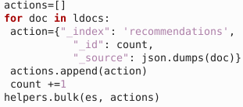
Customize the Recipe
After giving the recommendations, users can choose 1 or more foods in each category, and we will give the final recipe using Elasticsearch again (a new index):
Based on the distance from the total standard:

Slide 33
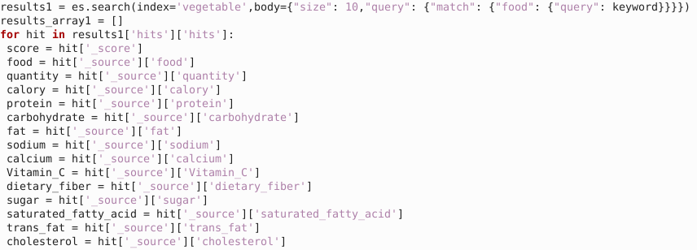
Retrive the Database
To search for a certain food and the related nutrients, Elasticsearch is also used in retrieving the all of the indexes:

Slide 34
05
Find Similar Users by Collaborative Filtering

Slide 35
Motivations and Goals
The same direction of choosing food within two person
Finding relation among many users
Using Collaborative Filtering (CF) to find the users with similar flavor to the current user.

Slide 36
Strategy
Step 1
Step 2
Step 3
Collect user information
Similarity algorithms: Pearson Correlation Coefficient, Cosine-based Similarity, and Adjusted Cosine Similarity.
The more common recommendation results include Top-N recommendation and relationship recommendation.
Nearest neighbor search (NNS)
“active scoring”
&
"passive scoring"
Generate recommendation results

Slide 37



Methodology
Find a collection of users with similar interests
Procedure
Calculation
Cosine Similarity
Recommending items

Slide 38
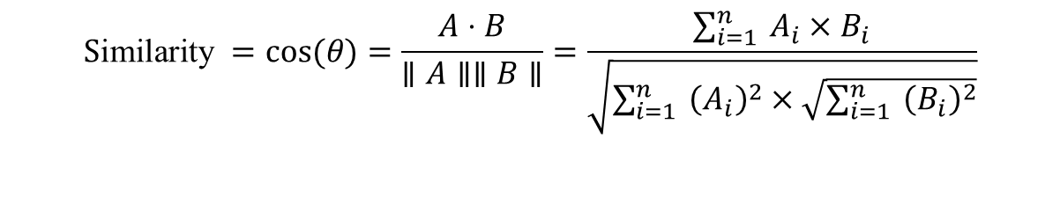

Methodology
$$\text{S}\text{imilarity} =cos⁡(θ)=\frac{A⋅B}{∥A∥∥B∥}=\frac{\sum_{i=1}^{n}{ }A_{i}×B_{i}}{\sqrt{\sum_{i=1}^{n}{ }{\left(A_{i}\right)}^{2}×\sqrt{\sum_{i=1}^{n}{ }{\left(B_{i}\right)}^{2}}}}$$
Assuming that the relevant food (encoding as 1-7) that user u and user v like and the frequency of eating in a week are as follows:
User/Food | 1 | 2 | 3 | 4 | 5 | 6 | 7
Jerry | 4 | 0 | 5 | 3 | 5 | 0 | 0
Tom | 0 | 4 | 0 | 4 | 0 | 5 | 0
Lily | 2 | 0 | 2 | 0 | 1 | 0 | 0
$$Cos\left(Jerry, Tom\right)=0.1835$$
$$Cos(Jerry, Lily) = 0.8853$$
Notes:
$$\text{similarity} =cos⁡(θ)=\frac{A⋅B}{∥A∥∥B∥}=\frac{\sum_{i=1}^{n}{ }A_{i}×B_{i}}{\sqrt{\sum_{i=1}^{n}{ }{\left(A_{i}\right)}^{2}×\sqrt{\sum_{i=1}^{n}{ }{\left(B_{i}\right)}^{2}}}}$$

Slide 39
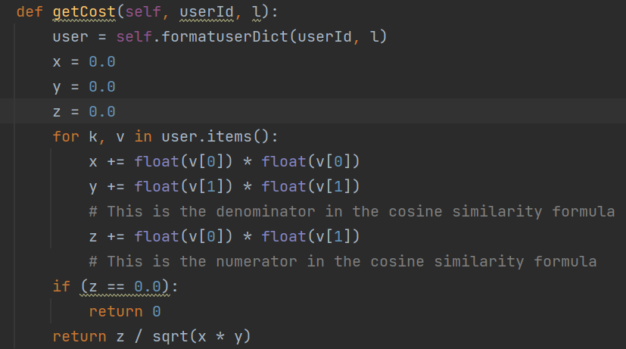
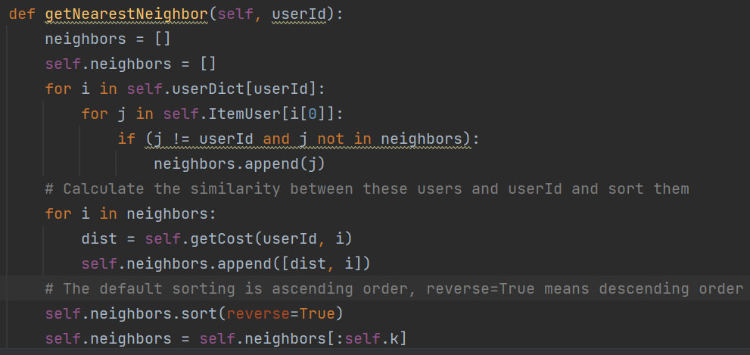
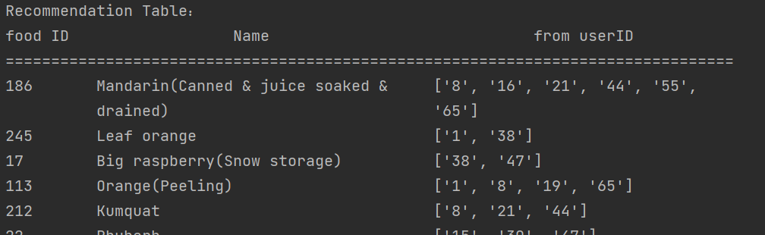
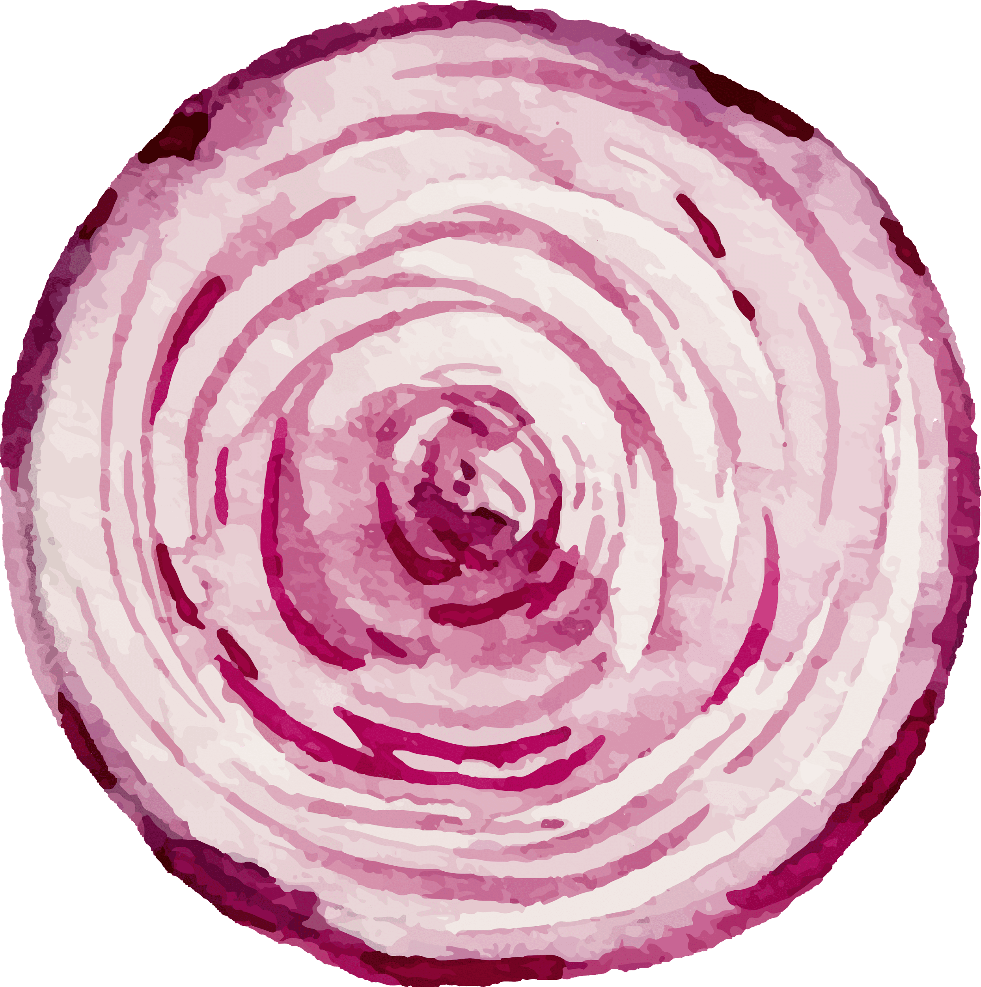
Implementation in Our System
calculating the cosine similarity number
listing them by the ascending order

Slide 40
06
Architecture of Web Interface

Slide 41
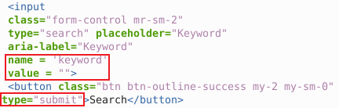
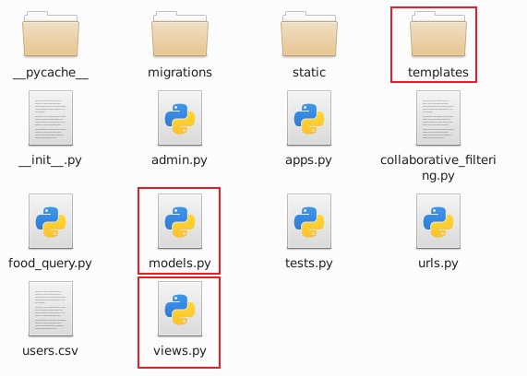
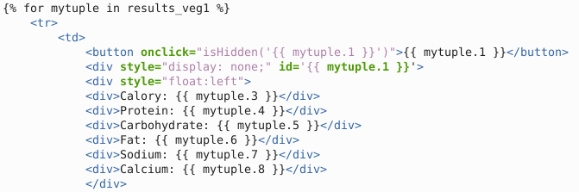
Website Architecture
Since basic functions of our system are implemented in Python, we adopted Django architecture for the construction of our website, which uses the MTV framework model: Model M, View V and Template T.
request (submit forms) to the backend:
7%
Or get the responds from backend

Slide 42
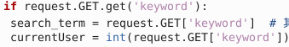
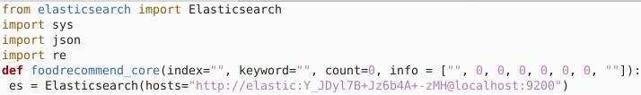
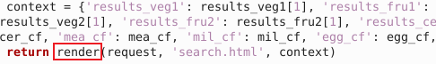
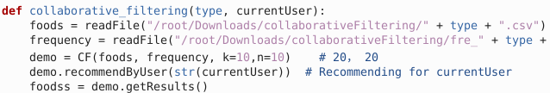
view.py
view.py includes the functions to respond the requests of each web page,
And thus call the function to conduct Elasticsearch searching (recommendation):
Or call the function of collaborative filtering to give recommendations based on users’ preference:
And finally, render these recommendations as responds to the frontend (HTML):

Slide 43
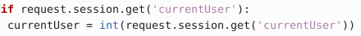
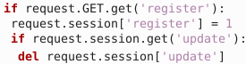
Sessions
Using the Sessions in Django, different pages can remember the status in cache (current login user, register & update status):
Read session
Write / delete session

Slide 44
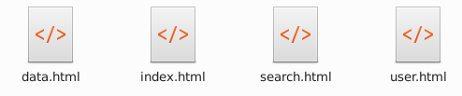
Website Frontend
Our website has 4 pages in total:
index.html for home page
search.html for recommendations
user.html for user information and history recording in real time
data.html for visualizing the foods & nutrients database

Slide 45


Index.html (Home Page)
User login & registration
Links to other pages

Slide 46
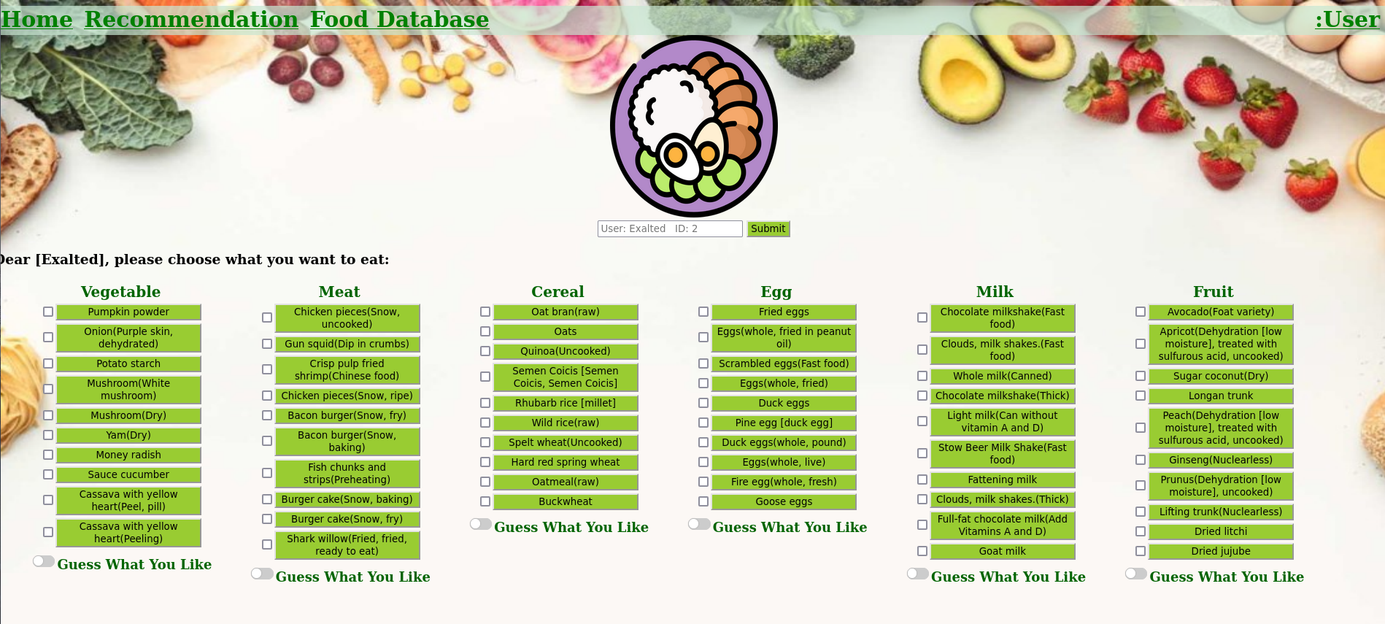
Search.html
Automatic recommendations of ES, “Guess What You Like” for CF, and recommended recipes

Slide 47
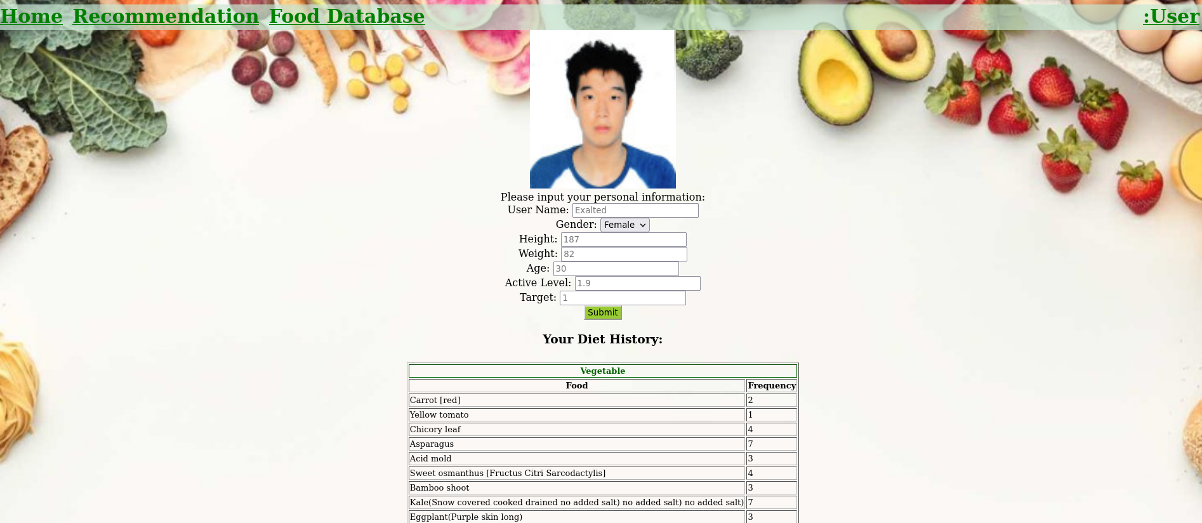
User.html
User info update & register
Diet history

Slide 48
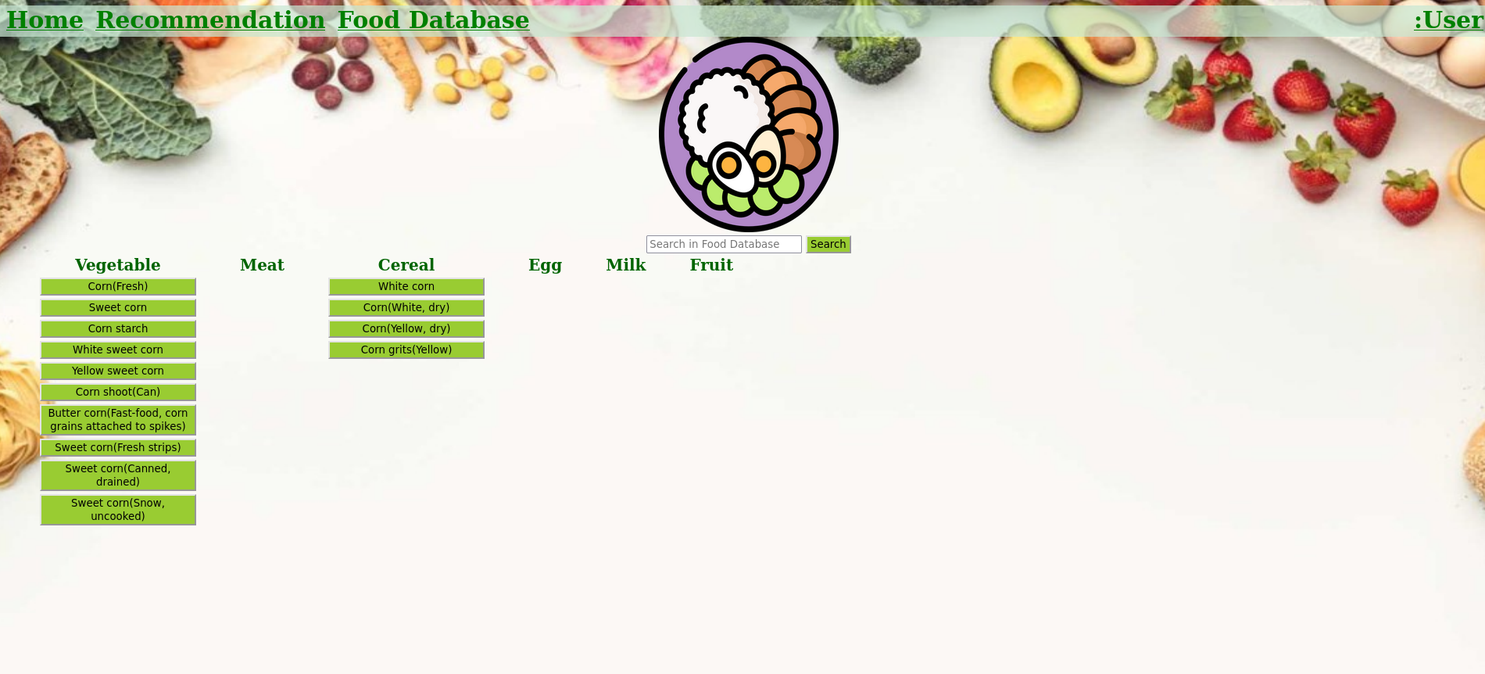
data.html
Search for foods in database using ES

